Slide 1
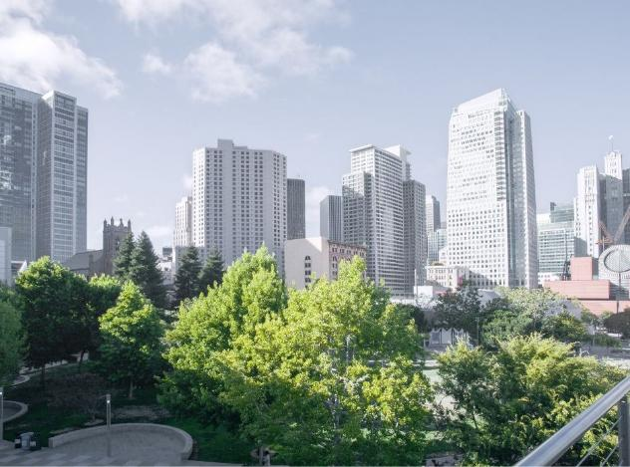
CarbiCrete:
Making Concrete a Climate Solution
Jacob Homiller
CarbiCrete
February 20, 2025
www.neuconcrete.org

Slide 2
Presentation Notes
Find presentation slides and post event recording at:
https://www.neuconcrete.org/events-and-education
Attendees are in listen only mode.
Ask questions via the Q&A dialog box in the zoom platform

Slide 3
Disclaimer
As with all concrete mixtures, trial batches should be performed to verify concrete properties. Results may vary due to a variety of circumstances, including temperature and mixture components, among other things.
You should consult your materials, cement, and concrete professionals for design assistance. Nothing contained herein shall be considered or construed as a warranty or guarantee, either expressed or implied, including any warranty of fitness for a particular purpose.

Slide 4
Poll Questions
Do you believe that there is a willingness in the market to pay a premium for low carbon concrete?
Do you expect projects you are involved with in 2025/2026 to require the use of low carbon concrete materials?
Do you think the market will prefer low carbon solutions that have obtained a validation or verification of environmental claims?

Slide 5
Today’s Speaker
Jacob Homiller
CEO of CarbiCrete
25+ years in senior leadership roles in global industrial companies
Former President and CEO of H.C. Starck Solutions
BA from Tufts, MBA from Wharton, MA from University of Pennsylvania

Slide 6
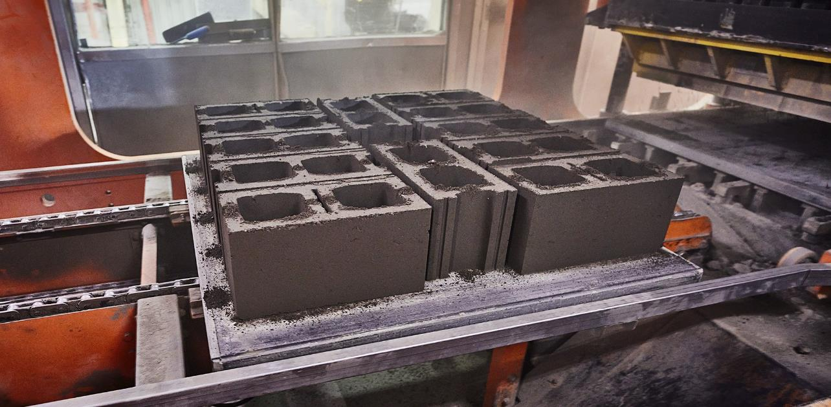
Making Concrete a Climate Solution
CarbiCrete technology enables the production of cement-free concrete made with steelmaking by-products and captured CO₂…avoiding emissions and permanently removing CO₂ from the atmosphere

Slide 7
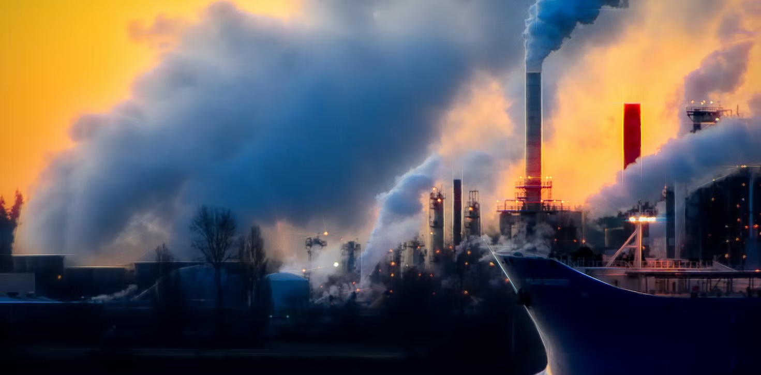
Cement: A Global Problem
Concrete is the most consumed substance on Earth after water
8%
Of global GHG emissions are from cement production
Cost of cement is high and forecasted to increase

Slide 8
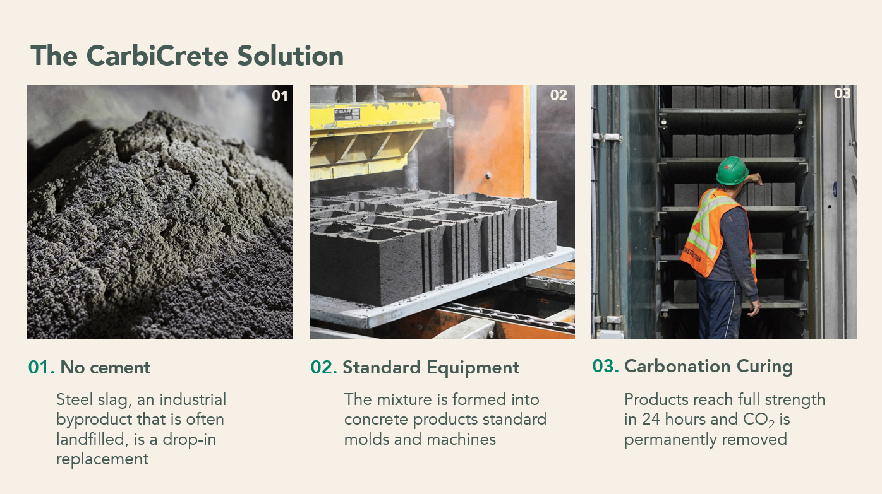
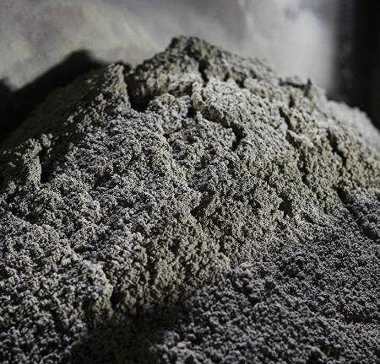
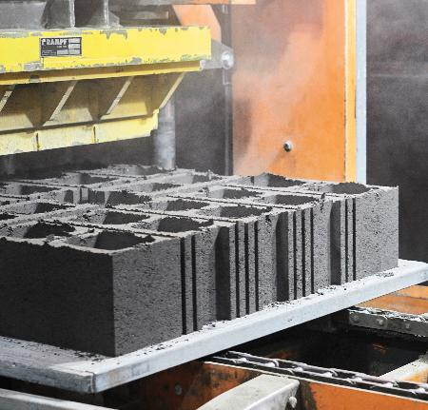
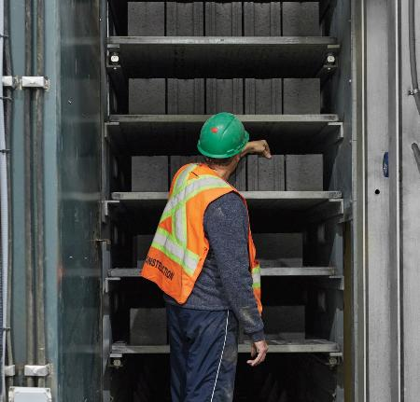
The CarbiCrete Solution
01
02
03
03. Carbonation Curing
01. No cement
02. Standard Equipment
Steel slag, an industrial byproduct that is often landfilled, is a drop-in replacement
The mixture is formed into concrete products standard molds and machines
Products reach full strength in 24 hours and CO₂ is permanently removed

Slide 9
CarbiCrete grinds steel slag into a powder and uses it as a drop-in replacement for cement in concrete-making.
Why steel slag?
Unlike iron slag (Granulated Blast Furnace Slag), steel slag reacts with CO₂ rather than with water. It is produced whenever steel is made and has limited applications, often ending up in landfills.
Using it in concrete production provides a sustainable solution for managing industrial waste by repurposing it into a valuable construction material.
Notes:
Not iron slag
Coming from steelmaking processes, mostly useless
Does not react with water but with CO2
Most of the cost comes from transporting and grinding it
As cement gets more expensive, SS more competitive

Slide 10
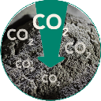
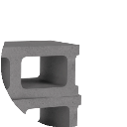
Carbonation Curing
Concrete products manufactured using CarbiCrete technology are cured with CO₂. During this process, the CO₂ becomes a solid mineral, giving the concrete its strength and eliminating the carbon permanently.
CO
2
CO₂ curing
CO₂ is removed forever when it reacts with the slag
Where does the CO₂ come from?
CarbiCrete currently uses biogenic CO₂ captured at ethanol plants, but the process is source-agnostic. DAC presents an very exciting future opportunity.
Formation of calcium silicate hydrates and calcium carbonates
CaCO₃
CaCO₃ (limestone)is formed within the concrete

Slide 11
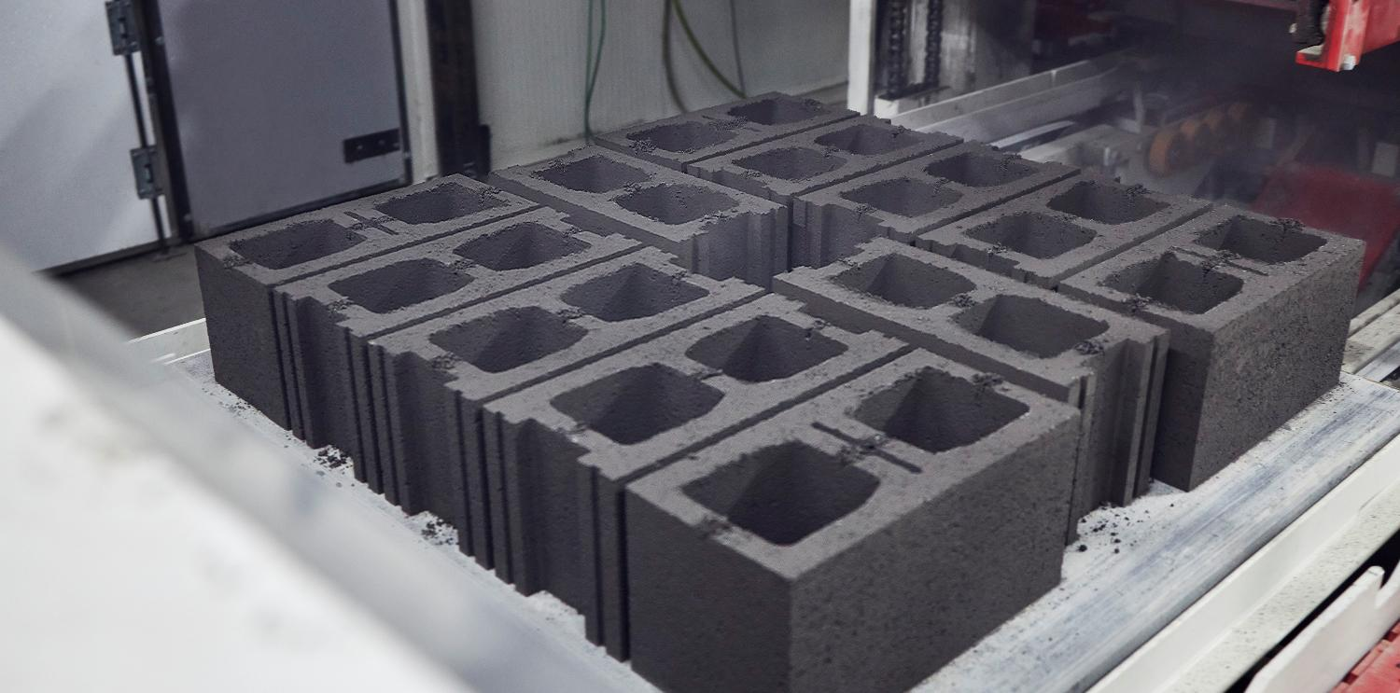
Emissions Avoided, Carbon Removed
1.5Kg
CO₂ emissions avoided per 18Kg CMU by replacing cement with steel slag
.5Kg
CO₂ removed per CMU during curing
2Kg
Of combined reductions and removals per CMU

Slide 12
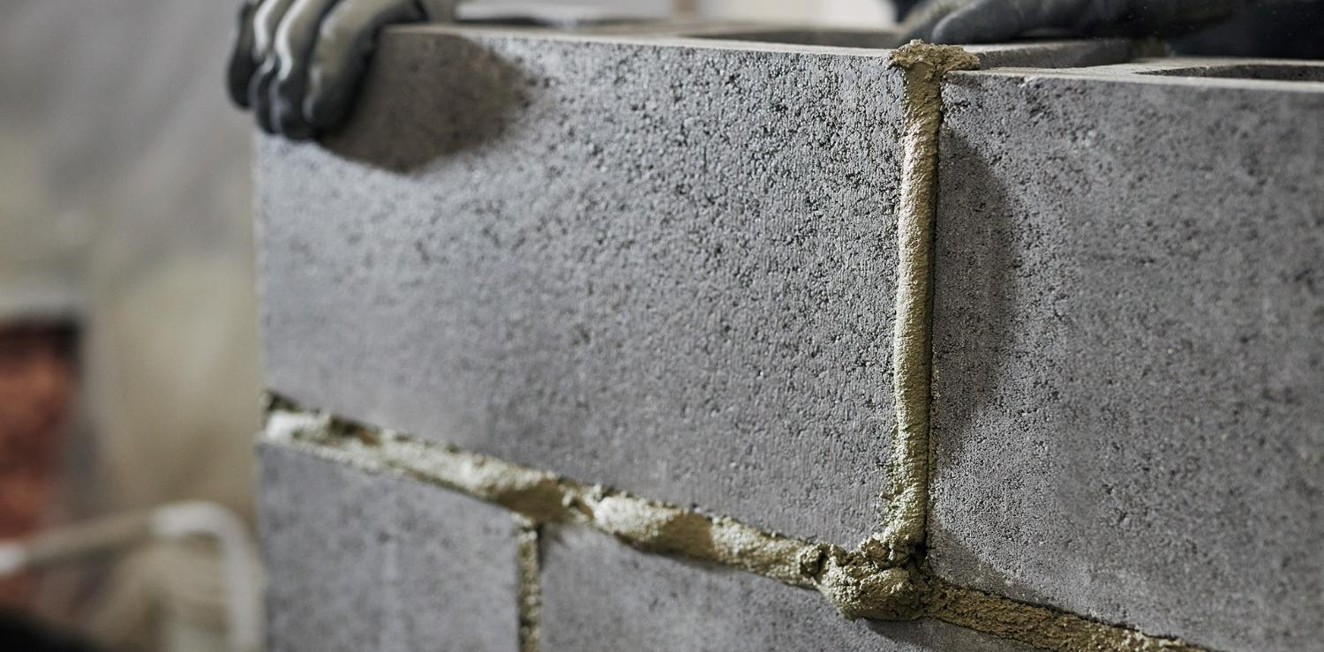
20X Lower GWP Than Industry Average
11.7
GWP
kg CO₂ eq / m³
CMUs in North America
(Industry avg. EPDs)
232
GWP
kg CO₂ eq / m³

Slide 13
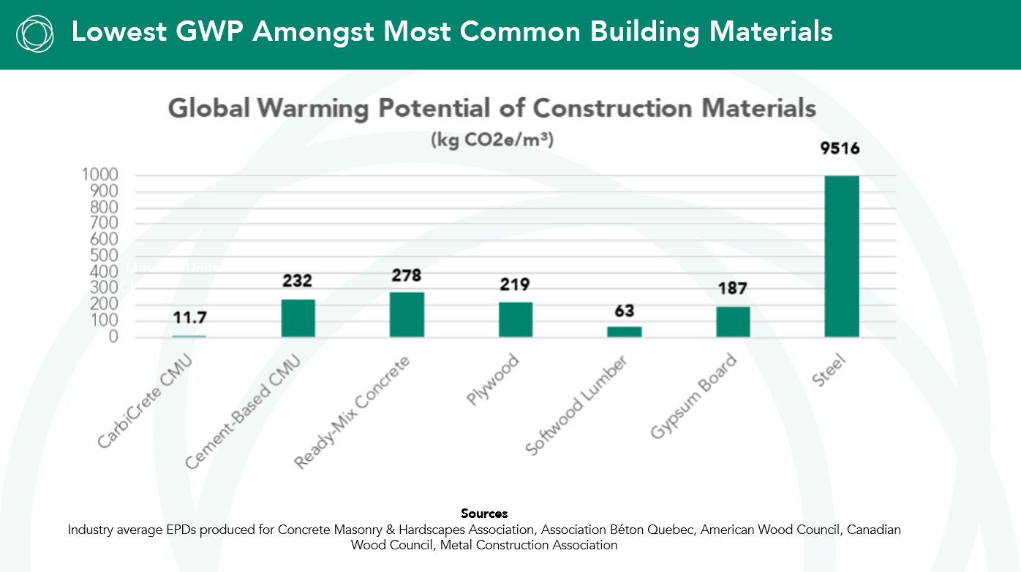
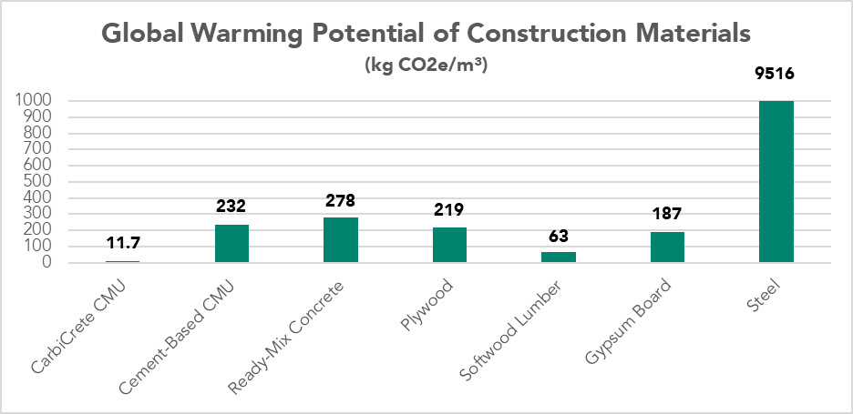
Lowest GWP Amongst Most Common Building Materials
Concrete Masonry Units
(CMUs)
Sources
Industry average EPDs produced for Concrete Masonry & Hardscapes Association, Association Béton Quebec, American Wood Council, Canadian Wood Council, Metal Construction Association

Slide 14
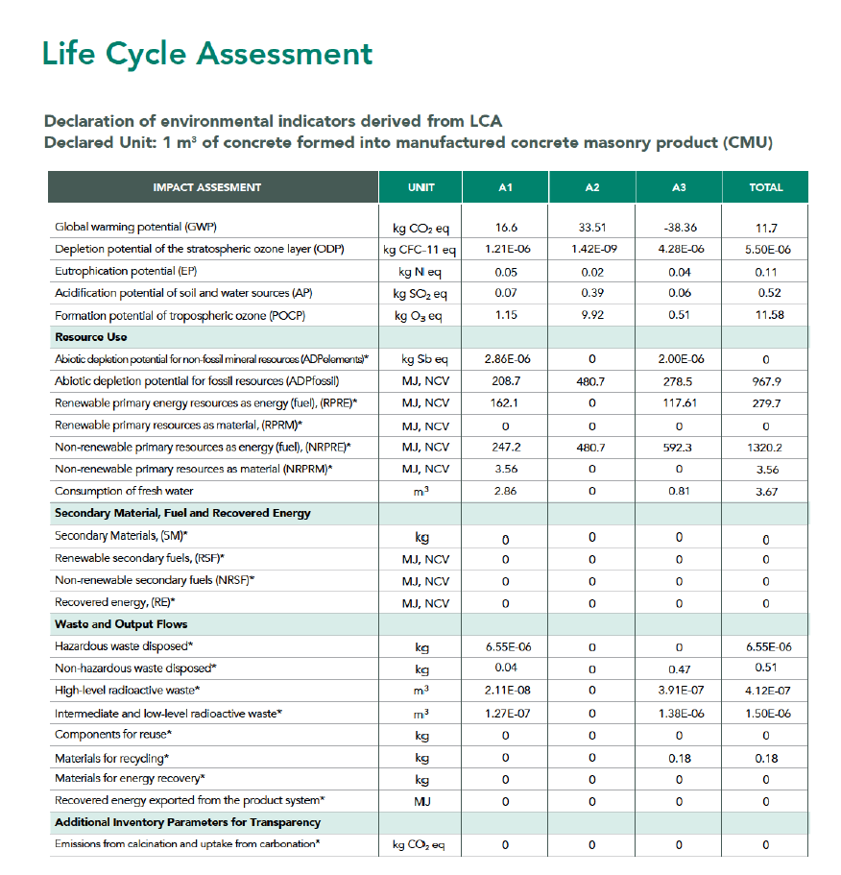
Environmental Product Declaration (EPD)
Provides precise data for sustainable impact
Shows a GWP 20 times lower than industry average, demonstrating significant emissions reductions
Highlights carbon footprint hotspots, enabling CarbiCrete to target improvements and innovate for further emissions reductions
Developed by
Verified by

Slide 15
Commercialization Through Licensing Partners
Licensees
Higher margins
Ability to win new jobs: low carbon concrete
New revenue streams: carbon financing
End Users
Ability to meet net-zero targets
LEED goals
Environmental benefits with same technical performance

Slide 16
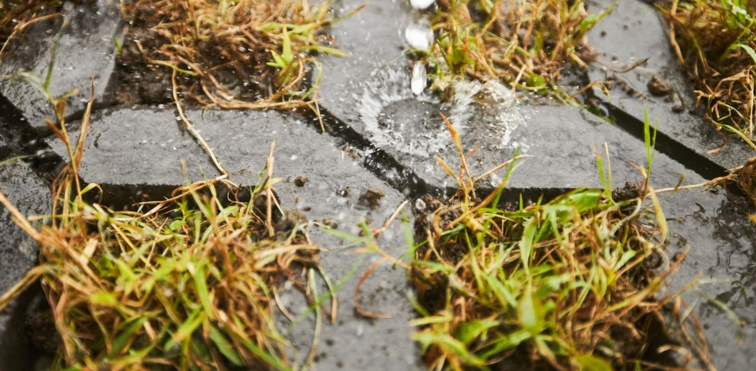
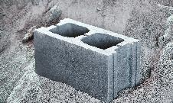
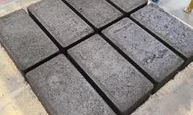
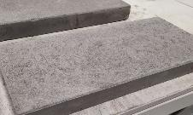
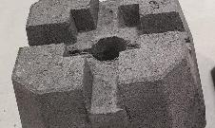
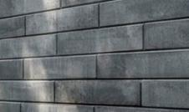
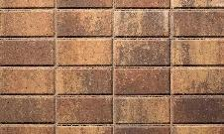
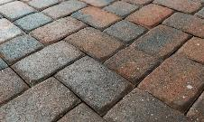
Expanding Product Portfolio
Current Portfolio
Concrete Masonry Units
(CMUs)
Pavers
(Hollandstone)
Concrete Slabs
Grow-Through Pavers
(Turfstone)
Deck Blocks
Product Development
Retaining Walls
Colored Pavers
Interlocking Pavers
Professional Pavers

Slide 17
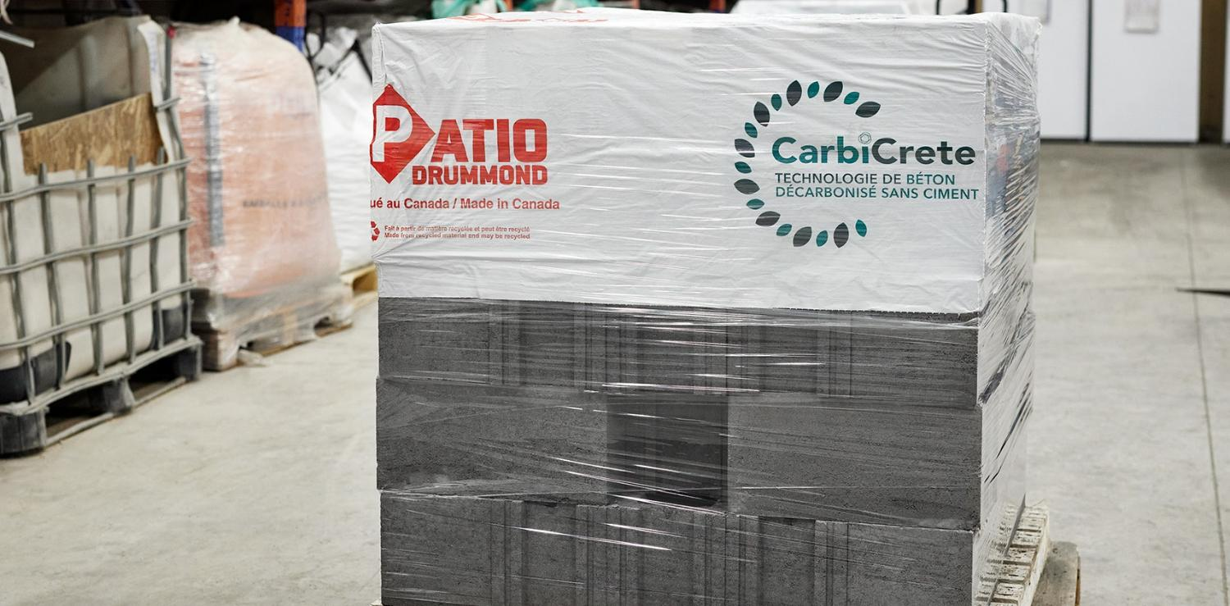
Products Available in Canada and US
First full-scale commercialization of cement-free CMUs in North America
Products on the market since early 2024
Sales supported by CarbiCrete-led co-operative marketing program
Licensing opportunities available
CANAL BLOCK

Slide 18
Questions?
Ask questions via the Q&A dialog box in the zoom platform

Slide 19
Thank you!
www.neuconcrete.org
info@neuconcrete.org
NEU: An ACI Center of Excellence for Carbon Neutral Concrete
@NEUCarbonNeutralConcrete
@NEUconcrete

