Slide 1
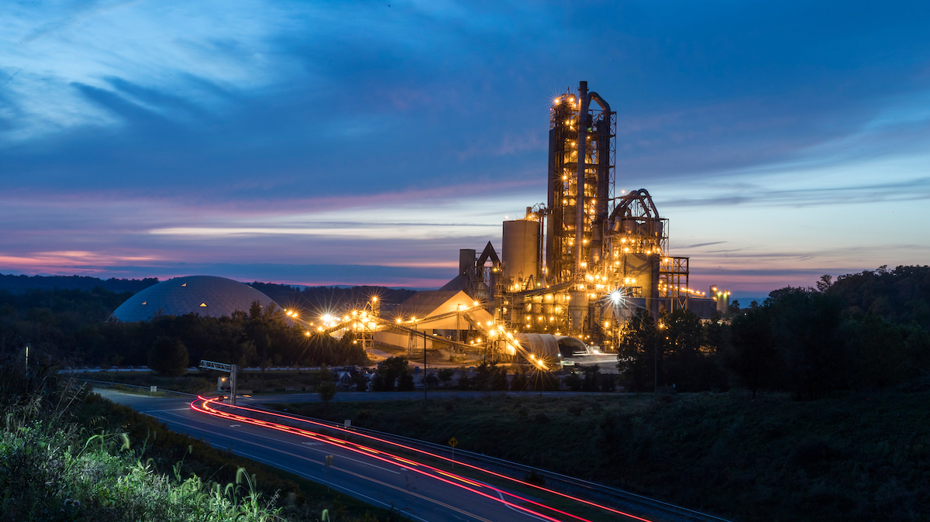

Heidelberg Materials
Is there a pathway to “Net Zero Concrete” ?

Slide 2

Presentation Notes
Find presentation slides and post event recording at:
  https://www.neuconcrete.org/events-and-education
Attendees are in listen only mode.
Ask questions via the Q&A dialog box in the zoom platform

Slide 3
Disclaimer
As with all concrete mixtures, trial batches should be performed to verify concrete properties. Results may vary due to a variety of circumstances, including temperature and mixture components, among other things.
You should consult your materials, cement, and concrete professionals for design assistance. Nothing contained herein shall be considered or construed as a warranty or guarantee, either expressed or implied, including any warranty of fitness for a particular purpose.

Slide 4
Presentation Overview
Ignacio Cariaga, commercial sustainability director with Heidelberg Materials, will attempt to provide the audience with some answers to the thought-provoking question: Does the concrete industry have a pathway to net zero concrete today without using offsets? Although the presentation will focus on Heidelberg Materials’ Carbon Capture Utilization and Storage (CCUS) in Edmonton, Alberta, Canada, it will also indicate that there is no single technology, lever, nor single company that can achieve net zero concrete without proper education, collaboration and advocacy work to ultimately change building codes. Technology readiness levels prove that the market might be ready for net zero concrete today … are you?

Slide 5
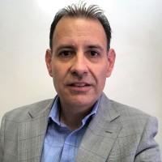
Today’s Speaker
Ignacio Cariaga, P. Eng. MBA
Ignacio Cariaga is a Civil Engineer with over 25 years of experience in companies leading the cement and concrete construction industry. As Commercial Sustainability Director with Heidelberg Materials, Ignacio is leading a team that is helping stakeholders throughout the concrete value chain to reduce embodied carbon in the built environment. Ignacio was co-founder of Carbon Leadership Forum in Alberta, Canada (CLF Alberta Hub) and active member of Canadian Precast Concrete Institute (CPCI) Sustainability Committee. He also represents Heidelberg Materials in materials CAN (Carbon Action Network) to help prioritize actions around the smart reductions of embodied carbon in building materials. He has extensive business development experiences and is passionate about understanding the construction market’s sustainability needs today to create lowest carbon solutions throughout the concrete value chain for tomorrow.

Slide 6
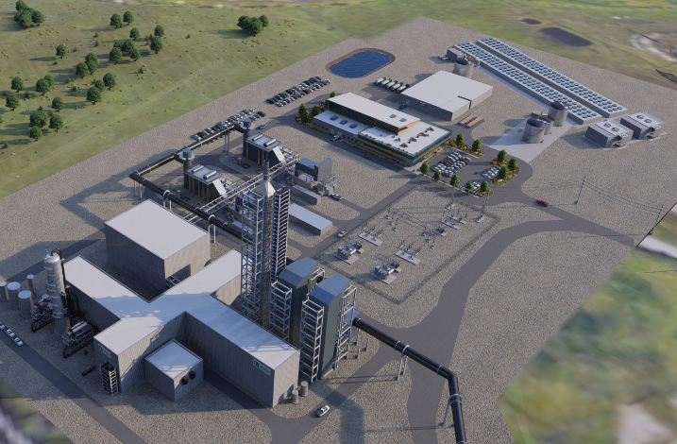
Agenda
Introduction to new brand Heidelberg Materials
Multidimensional Approach to “carbon free concrete”
Pathway example to carbon free concrete
How can we accelerate journey to carbon free concrete?

Slide 7
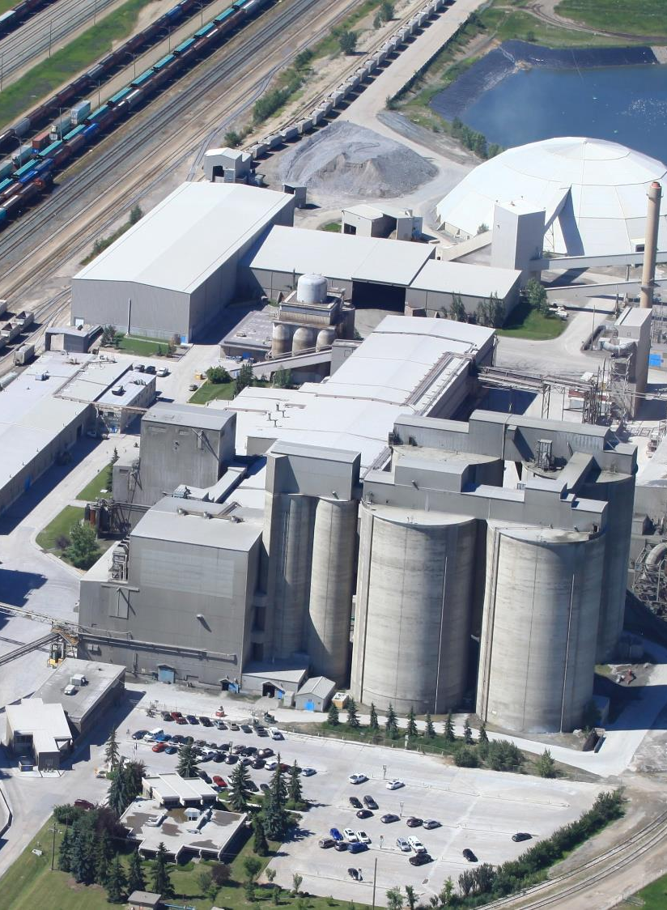
Learning Objectives
Is net zero concrete technology available today?
Is there a single technology, company or application that can get us to net zero concrete?
Who needs to participate in the pathway to net zero concrete?

Slide 8

Is Transitioning To
In January 2023

Slide 9



Heidelberg Materials North America
>450
manufacturing locations, distribution terminals and sales yards
~9,000
employees
in 28 states and 6 provinces
Leading positions in:
cement, aggregates, and
ready-mixed concrete
Heidelberg Materials is evolving our portfolio, products and services—providing the materials to build the future.

Slide 10
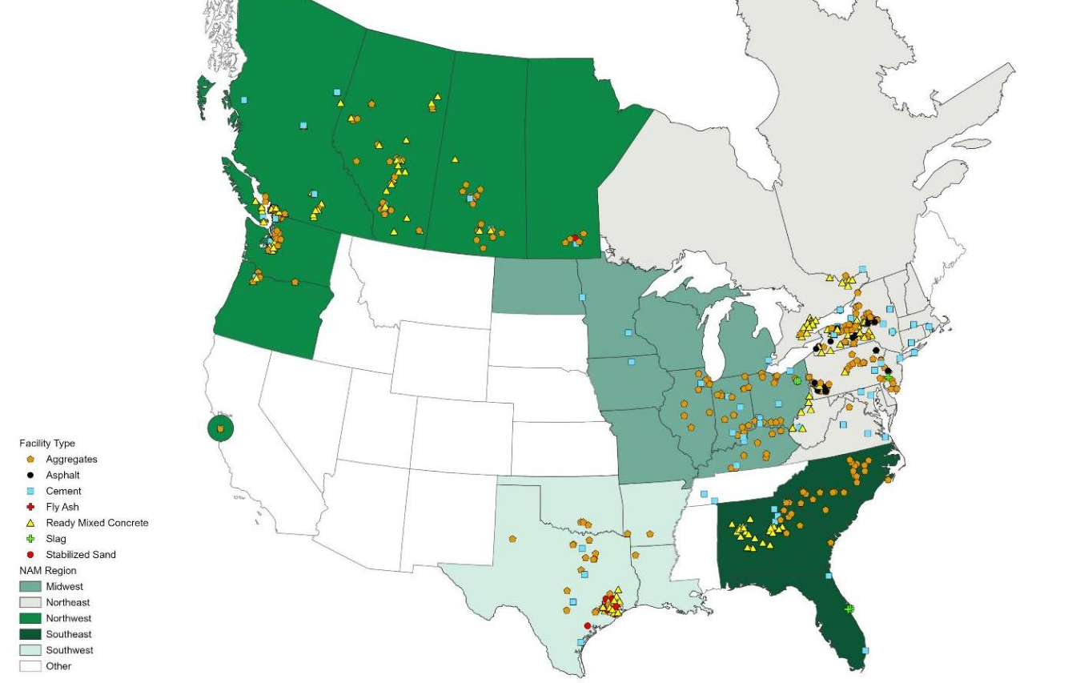
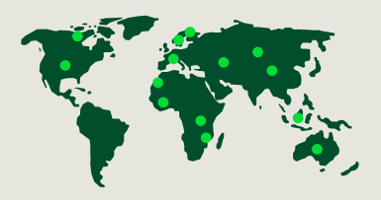
Our geographic footprint
Operations in 28 states and 6 provinces

Slide 11

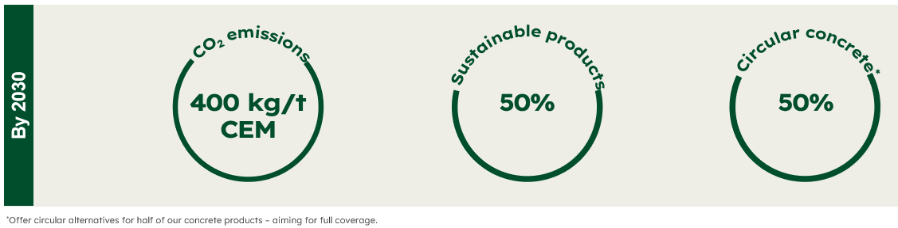
Heidelberg Materials global concrete promises
We focus on heavy building materials.
We commit to generate 50% of our revenue from sustainable products by 2030.
We commit to reduce CO₂ emissions by almost 50% to 400 kg CO₂/t CEM by 2030.
We will make this transition a successful business case:
on growth, margins, cash flow, ROIC, and leverage.
We drive the change for the benefit of our customers, our shareholders, our employees, and the society we live in.

Slide 12

Heidelberg Materials’ Roadmap to Net Zero Concrete –
Multidimensional Approach
Cement operations actively pursuing decarbonization across North America through:
Innovative products, including PLCs, composites cements, and expanded supplementary cementing materials offering
Innovative technologies, including lower carbon alternative fuels to displace fossil fuels
CCUS projects, including Edmonton and Mitchell production facilities

Slide 13
Path to carbon free cement:
Carbon Capture Utilization Storage (CCUS) Edmonton, AB
First in North America
Carbon free cement
Carbon free concrete without carbon offsets
First to examine feasibility of full-scale CCS in NA as a definitive solution to cut GHG emissions (target 90-95% capture rate)
Reducing 1,000,000 tonnes of CO2 annually
Operational in 2026/2027
VIDEO

Slide 14
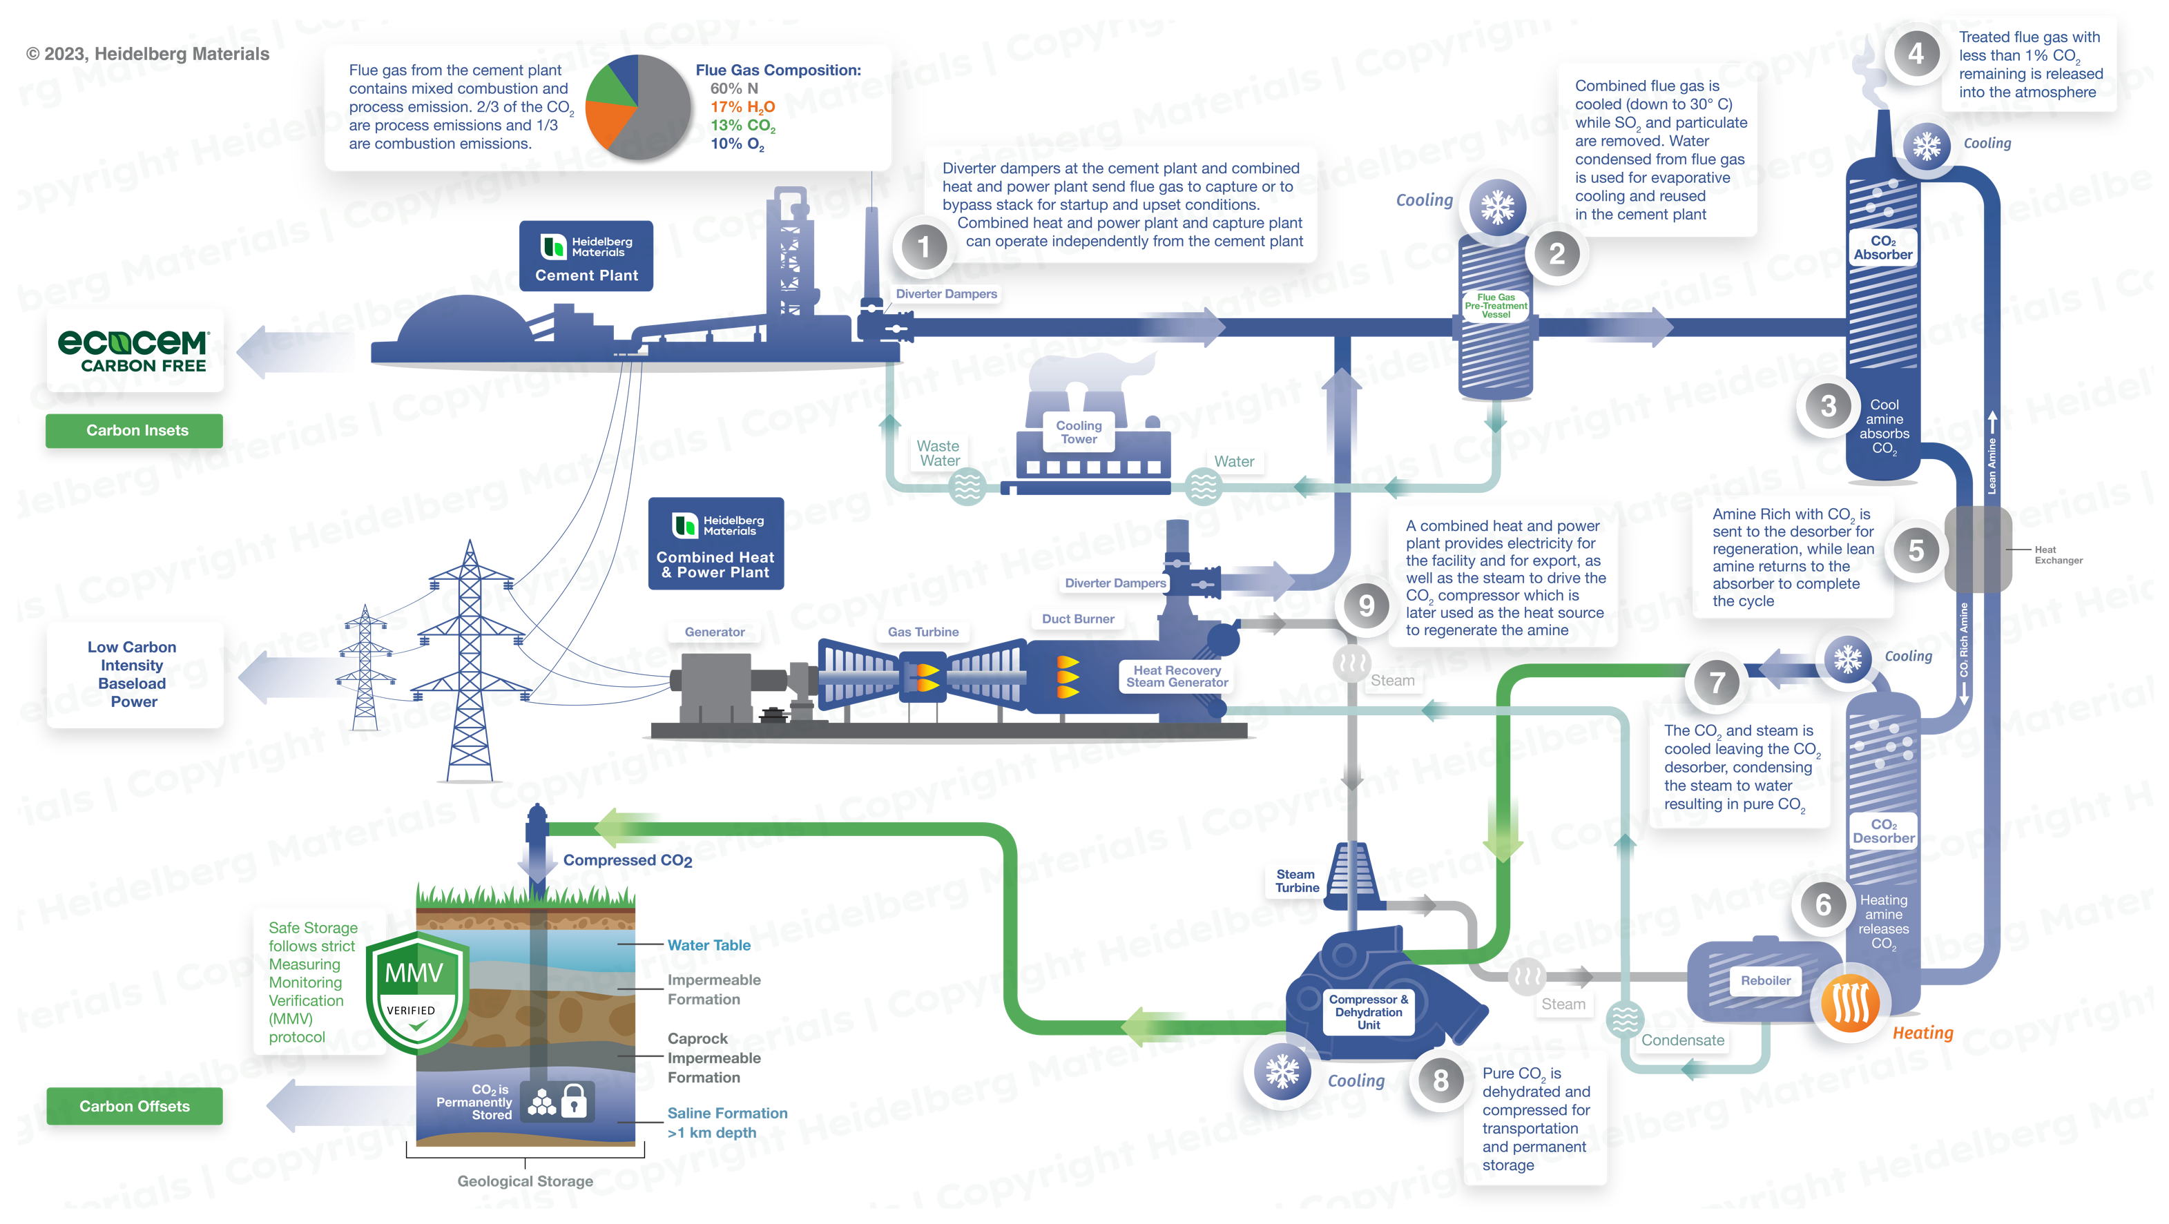
Process Overview
Edmonton CCUS Project
Innovative Project - Combines Cement and Clean Power with Emissions Reductions

Slide 15
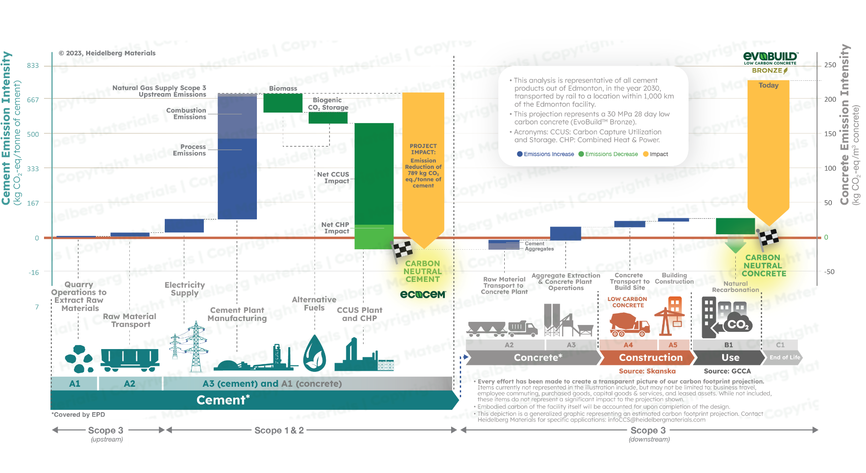

Heidelberg Materials Edmonton Cement CCUS: Carbon Footprint Projection

Slide 16
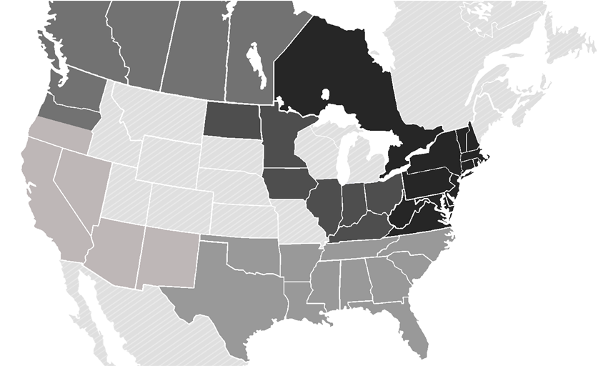

Growing demand for lower carbon construction materials
Compliance Policies
  The City of Vancouver, British Columbia
  The City of Portland, Oregon
  Marin County, California
  Treasury Board of Canada’s Low Carbon Concrete Procurement Policy (Forthcoming)
  US General Services Administration’s Facilities Standards for the Public Buildings Service
  Inflation Reduction Act 2022 – US Federal Gov.
Voluntary Project Examples:
  Seattle: Microsoft Project
  Seattle: Facebook Project
  Calgary: Amazon Warehouse
  Edmonton: Amazon Warehouse

Slide 17

What needs to change for us to accelerate new clean technology to finish line?
Is there a pathway to net zero concrete?
Education
  Throughout concrete value chain
Advocacy
  Cement PCR – Carbon Capture Storage language
  Concrete PCR –Inclusion of “use phase” – resiliency
  All PCRs- Global consistency
  Building Codes – Inclusion of Embodied Carbon Reductions
Collaborative design
  Integrative design: include material suppliers
  Meet Owner’s sustainability needs
    Include owners’ operational carbon needs
    Educate owners on emission reduction beyond construction – operations - end of life
Technology is ready… are you?

Slide 18
Thank You
Questions
02-09-2023
Pathway to carbon free concrete - OACI - Ignacio Cariaga

Slide 19



Thank you!
www.neuconcrete.org
info@neuconcrete.org
NEU: An ACI Center of Excellence for Carbon Neutral Concrete
@NEUCarbonNeutralConcrete
@NEUconcrete

