Slide 1

ABCs of Carbon Neutral Concrete: LCAs, EPDs, PCRs
Dean Frank, P.E.
NEU Executive Director
December 15, 2022
www.neuconcrete.org

Slide 2

Presentation Notes
Find presentation slides and post event recording at:
https://www.neuconcrete.org/events-and-education
Attendees are in listen only mode.
Ask questions via email at info@neuconcrete.org

Slide 3
Disclaimer
As with all concrete mixtures, trial batches should be performed to verify concrete properties. Results may vary due to a variety of circumstances, including temperature and mixture components, among other things.
You should consult your materials, cement, and concrete professionals for design assistance. Nothing contained herein shall be considered or construed as a warranty or guarantee, either expressed or implied, including any warranty of fitness for a particular purpose.

Slide 4

Learning Objectives
Learn about existing tools and processes related to assessing environmental information related to carbon neutrality of concrete
Learn how these tools and processes relate to and depend on each other

Slide 5

Today’s Speaker
Dean Frank, P.E.
Mr. Frank currently serves as the Executive Director of The NEU Center. He previously served as NEU Director of Validation and ACI Senior Program Developer and prior to that was the Principal/Consultant for Dean Frank Associates, LLC, Director of Quality & Sustainability Programs at the Precast/Prestressed Concrete Institute (PCI), and Director of Technical Services at the National Precast Concrete Association (NPCA).
He has been an active member of related industry committees, including ACI, ASTM International, PCI, and FIB for over 20-years. He obtained his MS degree in structural engineering from the University of Colorado at Boulder and is a registered Professional Engineer in Colorado and Indiana.

Slide 6
ABCs of Carbon Neutral Concrete: LCAs, EPDs, PCRs
Dean Frank, P.E.
NEU Executive Director
December 15, 2022
www.neuconcrete.org

Slide 7
What do we mean by Carbon Neutrality?
The term Carbon represents CO₂ released into the atmosphere.
Carbon Neutral: balancing carbon emissions with the absorption of carbon from the atmosphere through carbon sequestration, offsets, or sinks
Soil, forests, oceans (~9.5-11 GT )
Concrete
Notes:
So, do we mean by carbon neutrality?
The term Carbon represents CO2 released into the atmosphere.
Carbon Neutral: means that there is a neutral effect of CO2 in the atmosphere. - any emissions being released must be balanced by an equal amount of co2 being removed from the atmosphere either through carbon sequestration, offsets, and/or carbon sinks.
Sinks include soil, forest, oceans and even concrete – but these items can only absorb so much carbon.
Also, these natural sinks, like forests release that carbon if we have a forest fire for example.
That is why we need to reduce the carbon emissions within our processes, so we can get to a more balanced, or carbon neutral place.

Slide 8
What do we mean by Carbon Neutrality?
Carbon reduction is necessary to reach neutrality
Carbon offsetting from emissions made in one sector and reducing them elsewhere
Renewable energy, energy efficiency, lower carbon technologies
GOAL: Net Zero or zero emissions
Notes:
[Read slide]
Its important to keep in mind here that the goal is to get to zero emissions or net zero in the long term, and potentially even negative emissions (this is already happening in some places in Europe). However, the industrialized processes we all know today have some work to do to get there. So in the meantime, we focus on emission reduction and carbon neutrality.

Slide 9
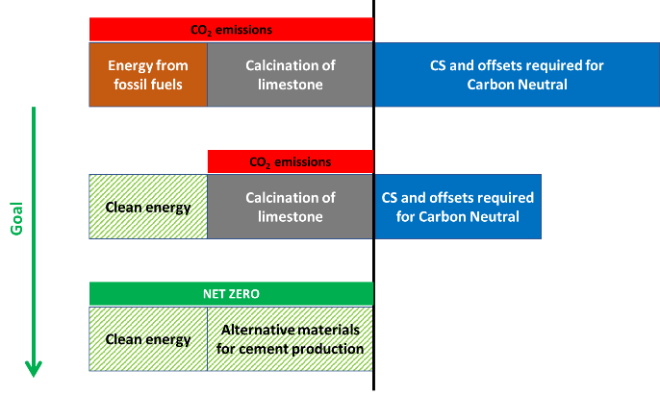
Carbon Neutral: Portland cement examples
CS = Carbon Sequestration
Notes:
This illustration generally shows progression to reach net zero for ordinary portland cement concrete

Slide 10
Why Focus on Carbon?
We know there is a lot more to sustainability than Global Warming
Environmental, Social and Economic factors all play into sustainability
We also know that concrete really shines in many areas related to sustainability
Resilience, thermal mass, durability, etc.
Global warming is affecting everyone on the planet

Slide 11
Why Focus on Carbon?
But we also know that the concrete industry is in an excellent position to improve upon the one area that tends to receive the most negative attention – CO₂ emissions
We can measure the amount of CO₂ associated with concrete
Can’t improve something without being able to measure it first

Slide 12
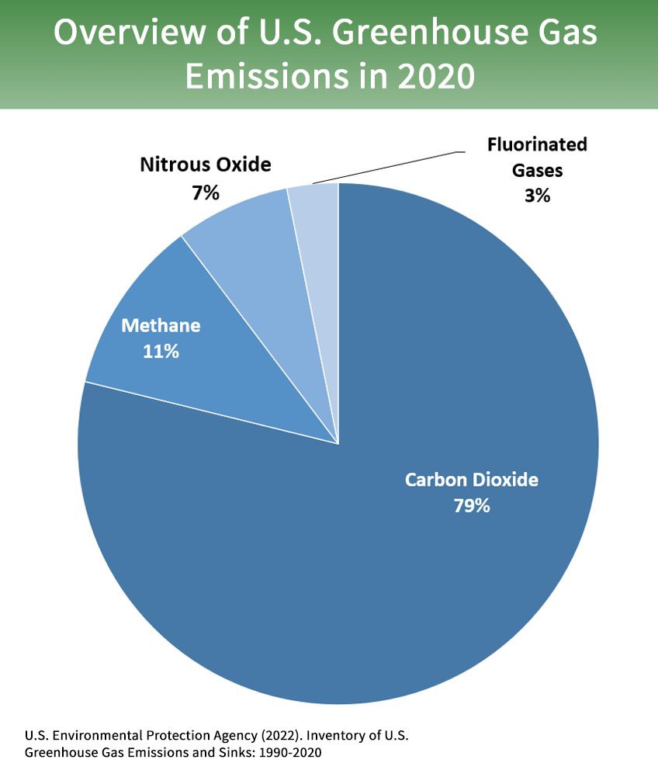
Definitions
Carbon Neutral
A neutral effect of CO₂ on the atmosphere
Net Zero
A neutral effect of all greenhouse gases on the atmosphere
Global Warming Potential (GWP)
A way to compare the long-term effect of different gases

Slide 13
Definitions
GHG = Greenhouse Gas
GWP = Global Warming Potential
CO2e (carbon dioxide equivalent or CO2equivalent) = CO2e is a measurement used to normalize the emissions from various greenhouse gases based on their GWP
Notes:
GHG
Carbon dioxide (CO₂): Carbon dioxide enters the atmosphere through burning fossil fuels (coal, natural gas, and oil), solid waste, trees and other biological materials, and also as a result of certain chemical reactions (e.g., manufacture of cement). Carbon dioxide is removed from the atmosphere (or "sequestered") when it is absorbed by plants as part of the biological carbon cycle.
Methane (CH₄): Methane is emitted during the production and transport of coal, natural gas, and oil. Methane emissions also result from livestock and other agricultural practices, land use and by the decay of organic waste in municipal solid waste landfills.
Nitrous oxide (N₂O): Nitrous oxide is emitted during agricultural, land use, and industrial activities; combustion of fossil fuels and solid waste; as well as during treatment of wastewater.
Fluorinated gases: Hydrofluorocarbons, perfluorocarbons, sulfur hexafluoride, and nitrogen trifluoride are synthetic, powerful greenhouse gases that are emitted from a variety of household, commercial, and industrial applications and processes.
GWP = a measure of how much energy the emissions of 1 ton of a gas will absorb over a given period of time, relative to the emissions of 1 ton of carbon dioxide (CO2)
ADDITIONAL SPEAKER NOTES:
CO₂, by definition, has a GWP of 1 regardless of the time period used, because it is the gas being used as the reference. CO₂ remains in the climate system for a very long time: CO₂ emissions cause increases in atmospheric concentrations of CO₂ that will last thousands of years.
Methane (CH₄) is estimated to have a GWP of 27-30 over 100 years (Learn why EPA's U.S. Inventory of Greenhouse Gas Emissions and Sinks uses a different value.). CH₄ emitted today lasts about a decade on average, which is much less time than CO₂. But CH₄ also absorbs much more energy than CO₂. The net effect of the shorter lifetime and higher energy absorption is reflected in the GWP. The CH₄ GWP also accounts for some indirect effects, such as the fact that CH₄ is a precursor to ozone, and ozone is itself a GHG.
Nitrous Oxide (N₂O) has a GWP 273 times that of CO₂ for a 100-year timescale. N₂O emitted today remains in the atmosphere for more than 100 years, on average.
Chlorofluorocarbons (CFCs), hydrofluorocarbons (HFCs), hydrochlorofluorocarbons (HCFCs), perfluorocarbons (PFCs), and sulfur hexafluoride (SF₆) are sometimes called high-GWP gases because, for a given amount of mass, they trap substantially more heat than CO₂. (The GWPs for these gases can be in the thousands or tens of thousands.)

Slide 14

Common Tools and Their Acronyms
LCA = life-cycle assessment
PCR = product category rule
EPD = environmental product declaration
EPDs rely on both anLCA and PCR
Notes:
Now let’s get to the main subject of today’s webinar…common tools related to sustainability and carbon neutrality

Slide 15
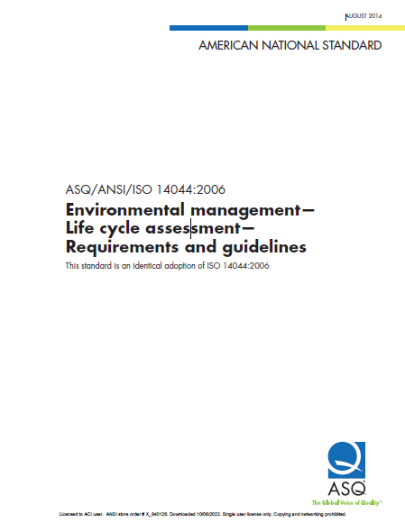
What is an LCA?
An LCA is a standardized method for examining a broad range of environmental impacts associated with a process or a product over its complete life cycle.
ISO 14044 Environmental management — Life cycle assessment — Requirements and guidelines

Slide 16
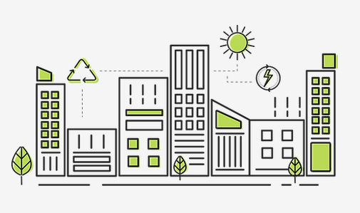
What is an LCA?
LCA is a form of Life-Cycle Analysis
LCCA = life-cycle cost analysis (economic)
LCA = life-cycle assessment (environmental)
Notes:
Life cycle analysis can be performed in terms of life cycle cost (economic) or life cycle impact (environmental).
Life cycle cost analysis (LCCA): Performed in terms of dollars. Includes construction, utility, maintenance, and replacement costs. A good method for comparing the economics of different alternatives with similar standards of service.
Life-cycle Assessment (LCA): which is essentially an environmental life-cycle performance evaluation

Slide 17
What is an LCA?
LCA evaluates the full environmental impact of the process or product
Full assessment of all associated impacts, rather than single criterion (i.e., GHG emissions)
LCAs are supported by science - not intended to be subjective
Notes:
Here are some key aspects of LCAs

Slide 18

What is an LCA?
A credible LCA requires:
Credible data:
Manufacturer data
Life-Cycle Inventory (LCI) database
A credible process:
ISO 14040
ISO 14044

Slide 19
What is an LCA?
A credible LCA requires:
Transparency:
External review team
Knowlegable consultant(s)
Conservative analysis
Especially with a comparative LCA

Slide 20
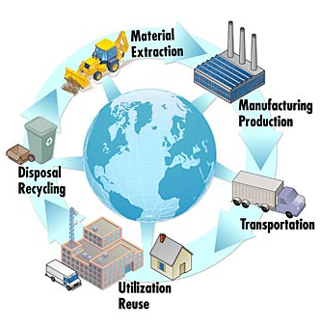
What is an LCA?
Includes environmental effects due to:
Raw material extraction and fuels used
Manufacture of components
Transportation
Assembly and construction
Operation and maintenance
Demolition, disposal, recycling, and reuse
(NIST)

Slide 21
What is an LCA?
Includes assessment of environmental impacts, such as:
Global warming potential
Acidification potential
Eutrophication potential
Smog creation potential
Ozone depletion potential
Total primary energy consumption
Etc.
Notes:
Global warming potential = the heat absorbed by any greenhouse gas in the atmosphere, as a multiple of the heat that would be absorbed by the same mass of carbon dioxide (CO2).
Acidification potential = refers to the amount that different compounds contribute to acid rain
Eutrophication potential = the potential to cause over-fertilization of water and soil, which can result in increased growth of biomass
Smog creation potential
Ozone depletion potential
Total primary energy consumption = can be broken down between energy from renewable and non-renewable sources

Slide 22
What is an LCA?
LCA consists of four iterative steps:
Goal and Scope – Sets boundaries
Life-cycle Inventory (LCI) - accounts for individual environmental flows (emissions, materials, and energy)
Life-cycle Impact Assessment (LCIA) – assesses the environmental impacts of each flow
Interpretation
Notes:
Purpose: Brief explanation of LCA
LCA consists of four iterative steps: Goal and Scope, LCI, LCIA, and Interpretation.
Goal and Scope sets boundaries. For example, cradle-to-grave LCAs are the most representative accounting of a product’s environmental impact because it includes all environmental impacts over the full life of the product.
Interpretation is where the hot spots are identified, or other goals for the study are summarized and assessed.
ISO Standard 14044 - Environmental management -- Life cycle assessment -- Requirements and guidelines
ISO 14044:2006 specifies requirements and provides guidelines for life cycle assessment (LCA) including: definition of the goal and scope of the LCA, the life cycle inventory analysis (LCI) phase, the life cycle impact assessment (LCIA) phase, the life cycle interpretation phase, reporting and critical review of the LCA, limitations of the LCA, relationship between the LCA phases, and conditions for use of value choices and optional elements.
ISO 14044:2006 covers life cycle assessment (LCA) studies and life cycle inventory (LCI) studies.

Slide 23
What is an LCA?
Life-cycle Inventory (LCI)
CO₂
N₂O
CH₄
NO_{x}
SO₂
CO
VOC
Air
Land
Water
Materials
Energy
Extracting
Disposal
Processing
Operations and Maintenance
Transporting
Assembly
Notes:
Purpose: More-detailed explanation of LCI
“This phase is most-involved for the producer or manufacturer during the LCA. It requires tracking of all materials, energy, and emissions associated with the object being studied.”
Tracking all things that affect the environmental impact.

Slide 24
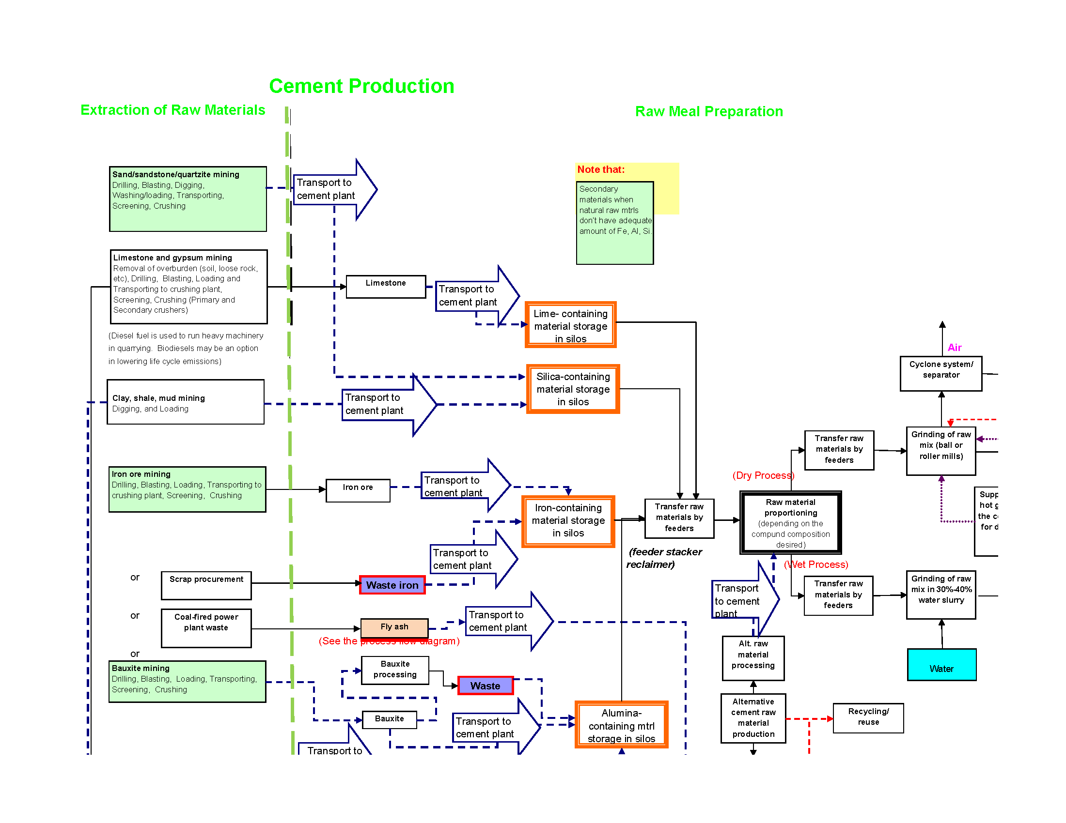
Notes:
Example of complexity

Slide 25
What is an LCA?
LCA = good tool, but complicated and expensive
Does not result in a single number
Typically, 50 to 100+ page report
Difficult to know what is the best choice, with respect to choosing the correct environmental impacts
Notes:
[Read slide]

Slide 26
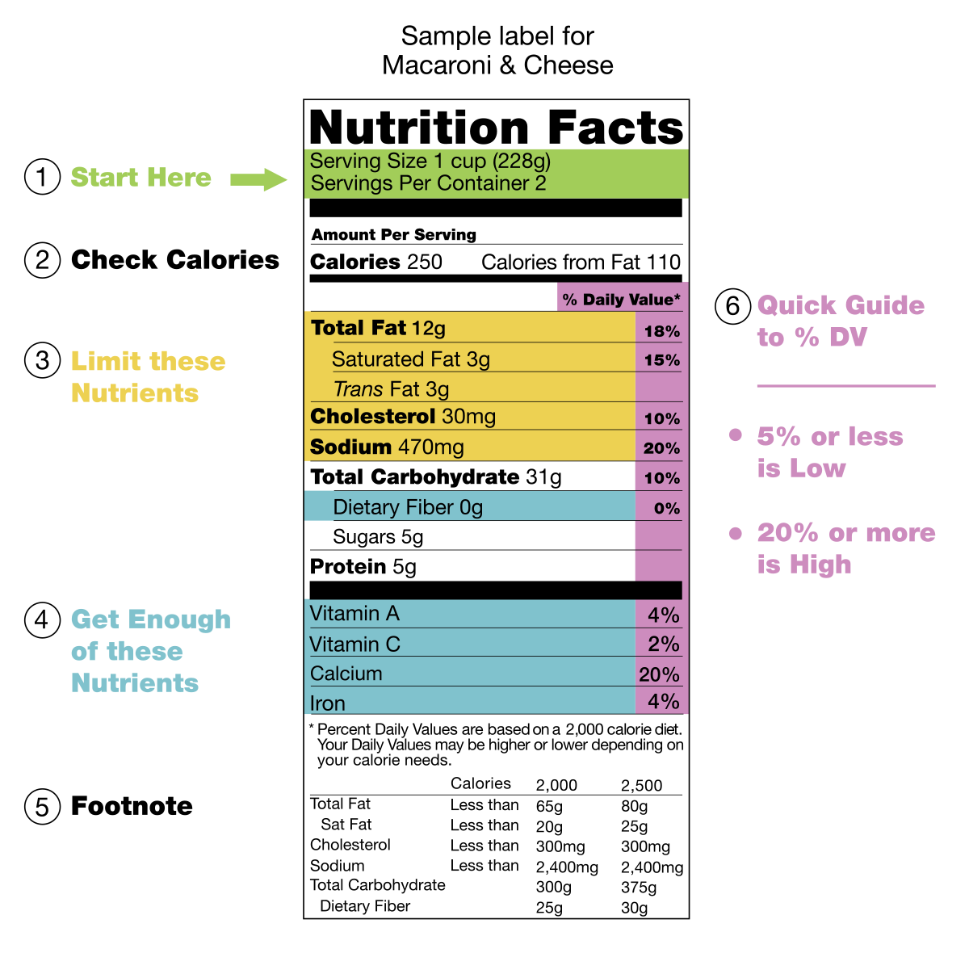
What is an LCA?
What we really need is a simplified summary
That we can use to compare similar products
That would be EPDs
Notes:
Purpose: Explain how LCA is the best tool we have, but it’s difficult for the practitioner to interpret.
“even though LCA is a good tool for determining environmental impact, arguably the best tool we have, it is complicated (and expensive) to perform an LCA. And in the end, LCA reports are usually difficult to wade through and determine what is the best choice in terms of environmental impact. Instead, more practitioners are now turning to environmental labels as a simplified and standardized summary of LCA results.”
[Know that LCA reports are typically 75-100 pp. or more]

Slide 27
What is an EPD?
Environmental Product Declaration
ISO 14025, Environmental Labels and Declarations—Type III Environmental Declarations
Based on LCI and LCA according to ISO 14040 series of standards, according to PCR
Major stakeholders included
Peer reviewed
Notes:
Purpose: Emphasize the Type III environmental labels (EPDs) are the only ones that are based on LCA.
“There are three types of environmental product declarations according to ISO standards, but only one type (Type III) is based on LCA and thus can report the full life-cycle impact. The ISO 14025 document sets the standard for type III environmental labels, and a few of the criteria are:
The LCI and LCA used to create the EPD must follow the ISO 14040 series of documents.
The EPD must be created according to a PCR
The EPD must be peer reviewed
This type of EPD is typically compared to a nutritional label (it lists more environmental impacts than just greenhouse gas emissions). By creating these labels for products in a similar way, we can ensure that the comparisons between products are more fair.”

Slide 28
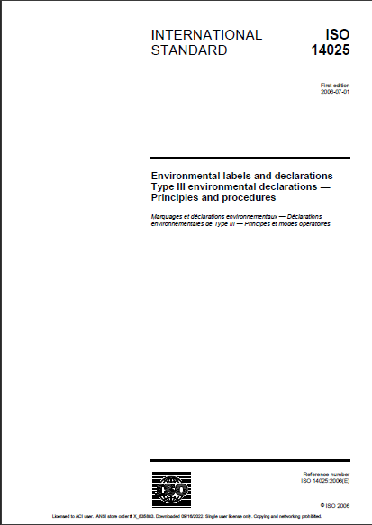
What is an EPD?
EPDs provide information on multiple sustainability attributes
Information in an EPD comes from an LCA
Thus, in order for product labels to be comparable from one similar product to another, Product Category Rules (PCRs) needed
Notes:
[Read slide]

Slide 29
What is a PCR?
A PCR provides instructions as to how to conduct the LCA in order to fulfill the requirements for compiling and presenting data in the EPD
A Product Category is a group of products that can fulfill equivalent functions - for example, 'floor tiles', 'concrete masonry units' or 'insulation'

Slide 30
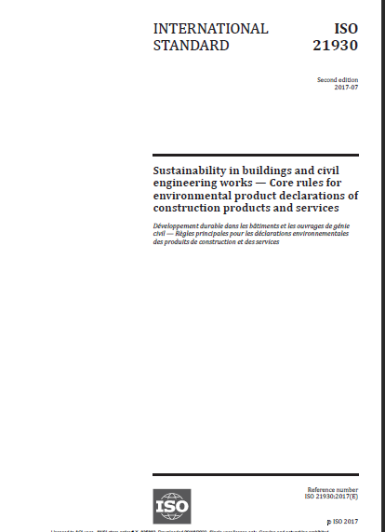
What is a PCR?
Created or administered by Program Operator
Separate PCR for each product category is required
Sets declared or functional unit for a category
Notes:
Purpose: Explain the role of PCRs in the development of EPDs.
Through the use of product category rules, or PCRs. Product category rules can be created by program operators (such as UL Environment or ICC-ES), or created by any other entity (such as a consultant, university, or industry) and adopted by a program operator.
Usually, a separate set of product category rules is created for each functional unit. So for concrete, a functional unit may be a cubic yard of concrete. So to compare to concrete mixes, you’d have to compare the environmental impacts associated with creating a cubic yard of each of the concrete mixes being compared.
Not only does the PCR state the relevant functional or declared unit, but it also sets the rules for how to conduct the LCA and includes information such as the LCA scope, info about the program and verifier, and details about what information should be included on the EPD label. How do we get to an EPD label?

Slide 31
What is a PCR?
Sets rules for LCAs and includes:
Goal and Scope
Life-cycle stages to include/exclude
Cradle-to-gate, cradle-to-grave
Life-cycle Inventory (LCI)—cut-off rules
Life-cycle Impact Assessment (LCIA)—assessment method, included impact categories
Notes:
[Read slide]
Purpose: Explain what a set of PCR includes in terms of rules for LCA.
“One of the two primary components of a PCR is to set rules for LCA. Some of the items that it would standardize would be the life-cycle stages that are included, or those that are excluded. It might specify that an LCA would only cover the cradle-to-gate life-cycle stages, or allow a full cradle-to-grave study. PCRs establish cut-off rules for data, so that materials or energy inputs that are less than a certain percentage (say 1 or 5%) need not be included in the study. The PCR also sets the impact categories that must be assessed, as well as the characterization method that shall be used convert LCI inputs and outputs to environmental impact categories.”

Slide 32
What is a PCR?
Also sets rules for the resulting EPD including:
Information about program operator and verifier
Required format for EPD label
Impact categories to list
Inventory items to list
Notes:
Purpose: Explain what a set of PCR includes in terms of rules for LCA.
“The other primary component of a PCR is to set rules for what is reported in an EPD. The PCR will set rules for [read slide]”

Slide 33
How do these things relate to each other?
So, in order to produce an EPD, an LCA must be conducted in accordance with the PCR and the resulting EPD must meet the rules set forth in the PCR
LCA
PCR
EPD
Notes:
Purpose: Explain what a set of PCR includes in terms of rules for LCA.
“The other primary component of a PCR is to set rules for what is reported in an EPD. The PCR will set rules for [read slide]”

Slide 34
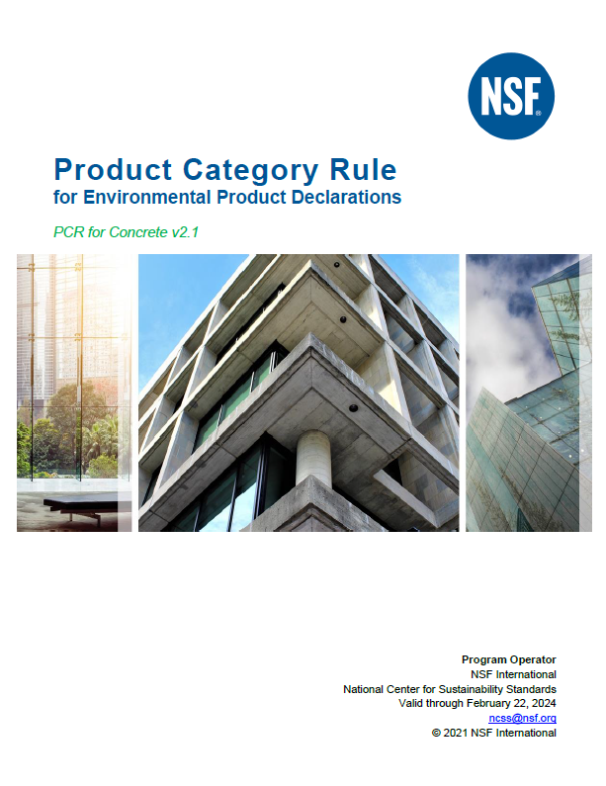
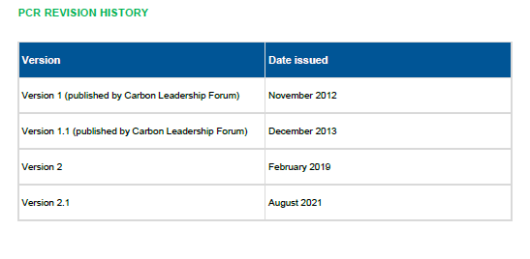
Concrete PCR
Initially published by the Carbon Leadership Forum

Slide 35
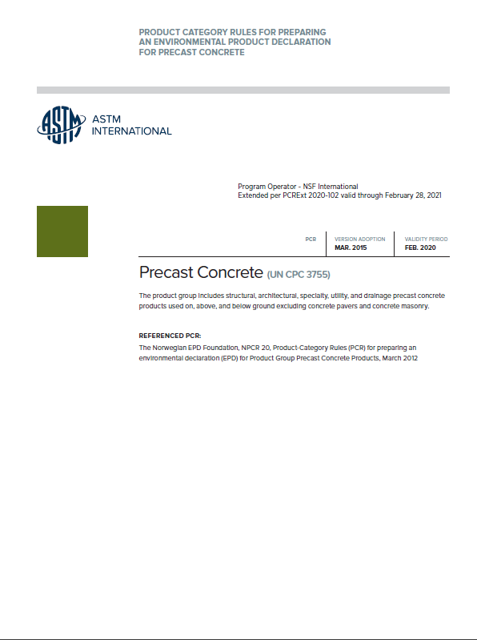
Precast Concrete PCR
Published by ASTM and supported by PCI and CPCI

Slide 36
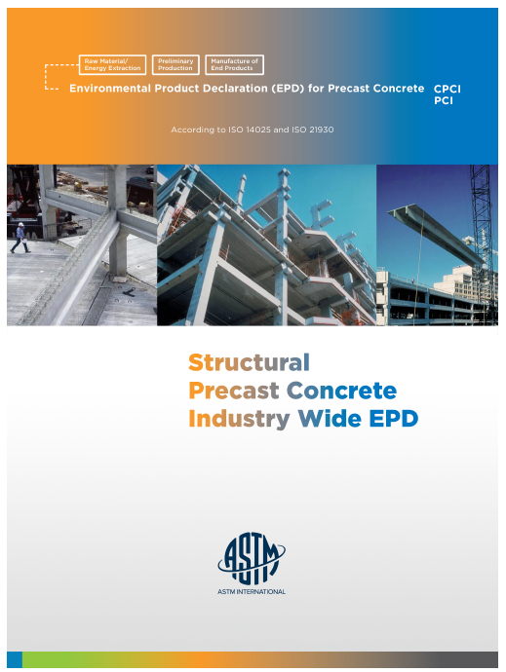
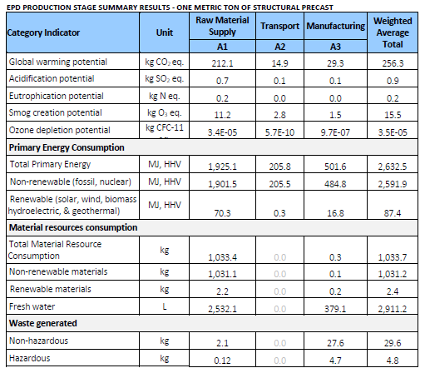
Precast Concrete EPDs
Published by ASTM and owned by PCI and CPCI

Slide 37
Learning Objectives Revisited
Learn about existing tools and processes related to assessing environmental information related to carbon neutrality of concrete
Learn how these tools and processes relate to and depend on each other

Slide 38

Vision
The Center envisions a concrete industry where all stakeholders have access to technologies and the knowledge needed to effectively and safely produce and place carbon-neutral concrete and concrete products in the built environment.

Slide 39

ACI Center of Excellence for Carbon-Neutral Concrete
Mission
Collaborate globally to drive research, education, awareness, and adoption of the use of carbon-neutral concrete materials and technologies in the built environment.

Slide 40





NEU Team
ACI Center of Excellence on Carbon-Neutral Concrete
Dean Frank, P.E.
Executive Director
Dr. Andrea Schokker Senior Technical Consultant
and Board Advisor
Kelly Dudley
Assistant Executive Director
Dr. Sureka Sumanasooriya
Technical Director
Kari Moosmann
Director of Marketing

Slide 41

NEU Validation Program (Upcoming Webinar)
What is Validation?
Validation: Process for evaluating reasonableness of the assumptions, limitations and methods that support an environmental statement about the outcome of future activities
Verification: Process for evaluating an environmental information statement based on historical data and information to determine whether the statement is materially correct and conforms to relevant criteria
In short…we are looking for assurance in the accuracy of manufacturers’ environmental claims…look for a future NEU webinar

Slide 42



Thank you!
www.neuconcrete.org
info@neuconcrete.org
NEU: An ACI Center of Excellence for Carbon Neutral Concrete
@NEUCarbonNeutralConcrete
@NEUconcrete

